Slide 1
Evaluating the Joint Effects of O₃, NO₂, and PM_{2.5} as an Exposure Mixture on Mortality
By Nisha Lingam
Advisor: Dr. Xiao Wu
Notes:
I’ll be presenting my practicum project, which looks at the joint effects of three major air pollutants - ozone , nitrogen dioxide, and fine particulate matter on all-cause mortality at the county level in New York State.

Slide 2


Background - Introduction
Epidemiological literature supports associations between PM₂.₅, NO₂, O₃ and mortality
WHO air quality guidelines are pollutant-specific
Evidence on multi-pollutant mixture effects is limited
Mixture models may better represent real-world exposure scenarios
Notes:
PM2.5 and NO2 are well-established individual contributors to mortality, and O3 is has a causal link to respiratory effects in the short and long-term. However, ambient pollution occurs as complex mixtures, and the cumulative impact of multiple pollutants remains under characterized. WHO acknowledges this gap, with their guidelines stemming from research that mostly focuses on air pollution effects using single-pollutant models.

Slide 3
Background - Study Objective
Investigate the overall mixture effect of PM₂.₅, NO₂, and O₃ on county-level mortality using:
Weighted Quantile Sum (WQS) regression
Quantile g-computation (QGComp)
Compare results from WQS regression and Quantile G-Computation
Assess how spatial and temporal confounding influence effect estimates
Geographic/Temporal Range: New York State, county-level (2000–2016)
Notes:
This study evaluates the joint effect of PM₂.₅, NO₂, and O₃ on all-cause mortality using two mixture modeling approaches. We compare two mixture modeling approaches: weighted quantile sum regression and quantile g-computation.
We aim to quantify the association between this air pollution mixture and mortality and evaluate how statistical assumptions and confounding structures influence the resulting effect estimates. WQS and QGComp offer complementary strengths for mixture inference.

Slide 4


Data Sources
Air Pollutant Data: Daily 1km² estimates from satellite-based prediction models (NASA/SEDAC)
Mortality & Population: All-cause monthly mortality per county (CDC WONDER)
Covariates: Race/ethnicity proportions, median income, owner-occupied housing, median age, NDVI (US Census and NASA MODIS)
Data was aggregated for all 62 NY counties by month from 2000-2016
Notes:
Air pollution data came from satellite-based modeled estimates and was aggregated monthly at the county level. Mortality and population data came from the CDC, and covariate data were drawn from census and environmental sources. NDVI was used to account for greenness, serving as a proxy for environmental quality. All data was aggregated to the county level, individual observations occurring for each month and county.

Slide 5
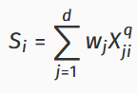
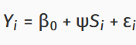
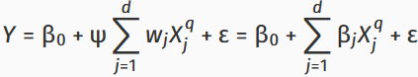
Methods - WQS Regression
Categorically transforms exposures into quantile-based categories
Constructs a regression model between the outcome and an exposure index as a weighted sum of quantiles
Includes a set of weights quantifying each exposure’s contribution, all forced to sum 1.0
Assumes directionally homogeneous effects (all weights constrained to same sign)
Ψ: coefficient representing change in expected value of the outcome per unit increase in S_{i}
S_{i}: exposure index
w_{j}: weights for d exposures
X_{ji}: quantized version of jth exposure for ith individual
Notes:
WQS regression categorically transforms exposures into quantile-based categories - I chose to use deciles for this study based on previous studies looking at the relationship between other air pollutant mixtures and mortality.
Includes a set of weights quantifying each exposure’s contribution to the exposure index and effect estimate
WQS reduces multicollinearity among exposures by constructing an index. However, it imposes directional homogeneity, potentially biasing effect estimates if some pollutants have opposing effects.

Slide 6
Methods - Quantile g-computation
Generalization of WQS using g-computation (g-formula): allows for parameter estimation of a marginal structural model -> valid inference of mixture effect and single-pollutant contributions
Allows weights in both positive and negative directions
Can account for potential nonlinearity
Much quicker and more efficient that WQS alone
Notes:
QGComp addresses these limitations of WQS by allowing directional heterogeneity and nonlinear modeling. It provides a more flexible framework for causal inference under appropriate assumptions - no unmeasured confounding, but no need for directional homogeneity.
WQS - only under no unmeasured confounding, large sample sizes, and directional homogeneity assumptions, can causal effects be estimated
When bootstrapping, individual weights are not calculated using the qgcomp() package.

Slide 7
Model Specifications
Poisson link function used due to count outcome (quasi-Poisson link for WQS)
Models included spatial fixed effects, spline-adjusted temporal effects, or both
Testing for robustness to spatial and temporal confounding
Natural spline on time (df=10) selected via AIC minimization
Six models total: three per method (WQS, QGComp)
Notes:
The gwqs() package in R was used to produce the WQS regression models, while the qgcomp() package was used to produce the quantile g-computed models.
To evaluate potential confounding, I ran three sets of models with different adjustment strategies: spatial-only, temporal-only, and joint spatial-temporal adjustment. All models used a Poisson link function and included multiple covariates.

Slide 8
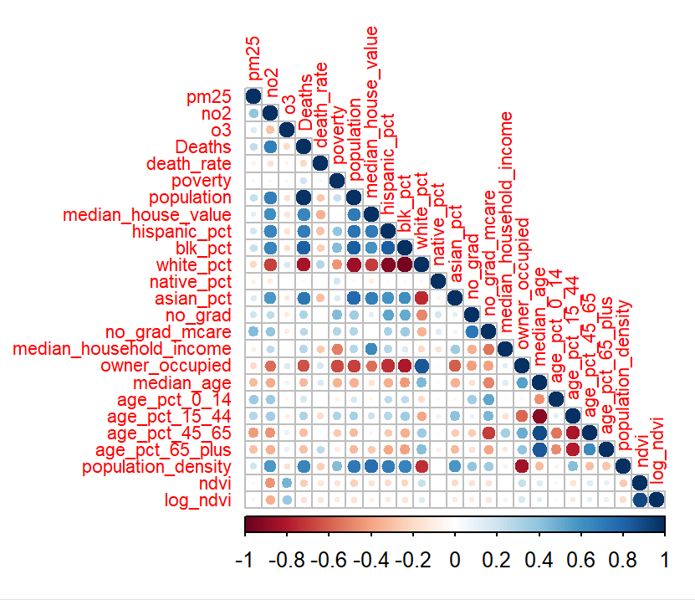
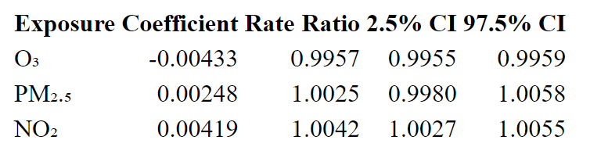
Results - Data Characterization
Correlation Matrix
Weak correlation between pollutants
Stronger correlations observed between mortality and demographic variables (e.g., % of residents who did not graduate high school, income, property ownership, etc.)
Poisson Generalized Linear Models
NO₂: positive association
O₃: negative association
PM₂.₅: no significant association
Adjusted with county-level fixed effects
Notes:
The exposure variables were not strongly correlated, which mitigates concerns about collinearity in the mixture models. Stronger associations between mortality and race/income highlight the importance of adjusting for structural and demographic factors.
When evaluated individually, only NO₂ showed a modest positive association with mortality, while O₃ had a small negative effect and PM₂.₅ was not statistically significant. These results may reflect confounding or suppression effects.

Slide 9
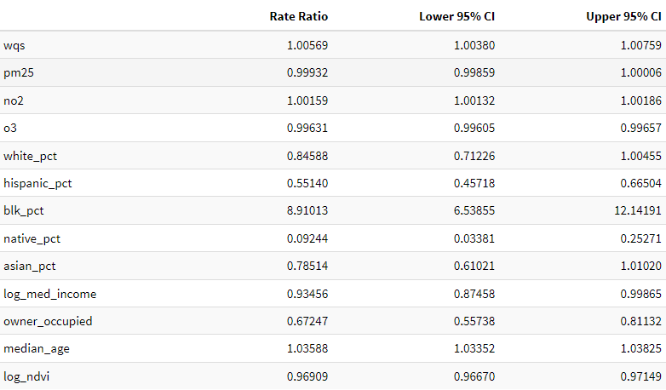
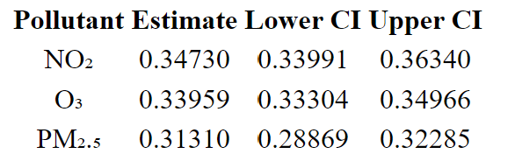
Results - WQS Regression
Model 1 (Spatial + Temporal):
RR = 1.006 [95% CI: 1.004, 1.008]
Ψ is represented as wqs
Notes:
The WQS model adjusting for both spatial and temporal confounding yielded a small but significant increase in mortality risk per decile increase in exposure mixture. The effect was attenuated when adjusting for spatial confounding alone and maximized when only temporal confounding was adjusted.

Slide 10
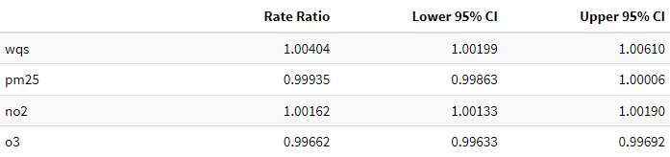
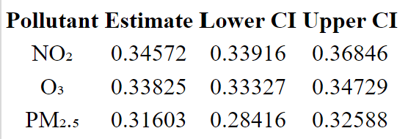
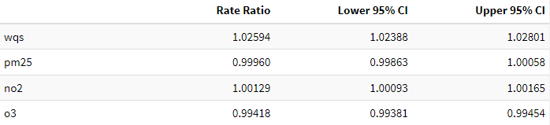
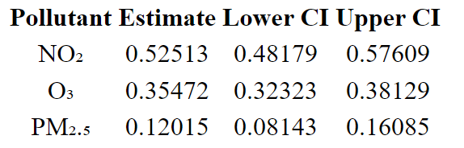
Results - WQS Regression (cont.)
Model 2 (Spatial Only): RR = 1.004 [95% CI: 1.002, 1.006]
Model 3 (Temporal Only): RR = 1.026 [95% CI: 1.024, 1.028]
Notes:
The relative contributions of each pollutant to the mixture effect varied across models. NO₂ had the highest weight in the temporally adjusted model, suggesting time-related confounding may influence attribution of mixture effects.

Slide 11
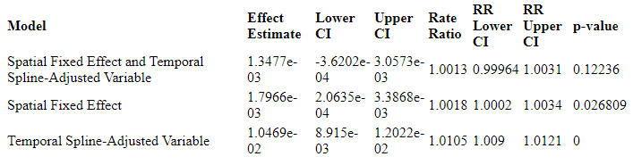
Results - Quantile g-computation
3-Model Summary
Notes:
The QGComp model showed no statistically significant association when adjusting for both spatial and temporal factors. The effect increased slightly when only spatial confounding was adjusted, and was most pronounced under temporal-only adjustment—mirroring the WQS findings.

Slide 12
Discussion
Interpretation & Implications
No strong evidence for large-scale mixture effects
Temporal adjustment alone suggests greater positive association
Differences between models underscore sensitivity to spatial and temporal confounding
NO₂ appears to be the predominant contributor when effects based on sensitivity analysis and WQS models
Limitations
Geographical restriction to NY State limits statistical power
County-level aggregation may obscure individual-level variation and create difficulties for stratified analyses
No cause-specific mortality analysis
Quantile transformation may reduce interpretability and lead to an inevitable loss of information
Spatial fixed effects may inadequately capture local variability
Notes:
While results vary by modeling approach and adjustment structure, overall mixture effects were small. Temporal confounding appears to play a key role in effect attenuation. NO₂ was consistently more influential in the models with significant effects.
Several limitations must be considered. County-level data may mask finer-scale exposure-outcome relationships. Additionally, using fixed rather than random effects constrains the capacity to model variability at the county level.

Slide 13
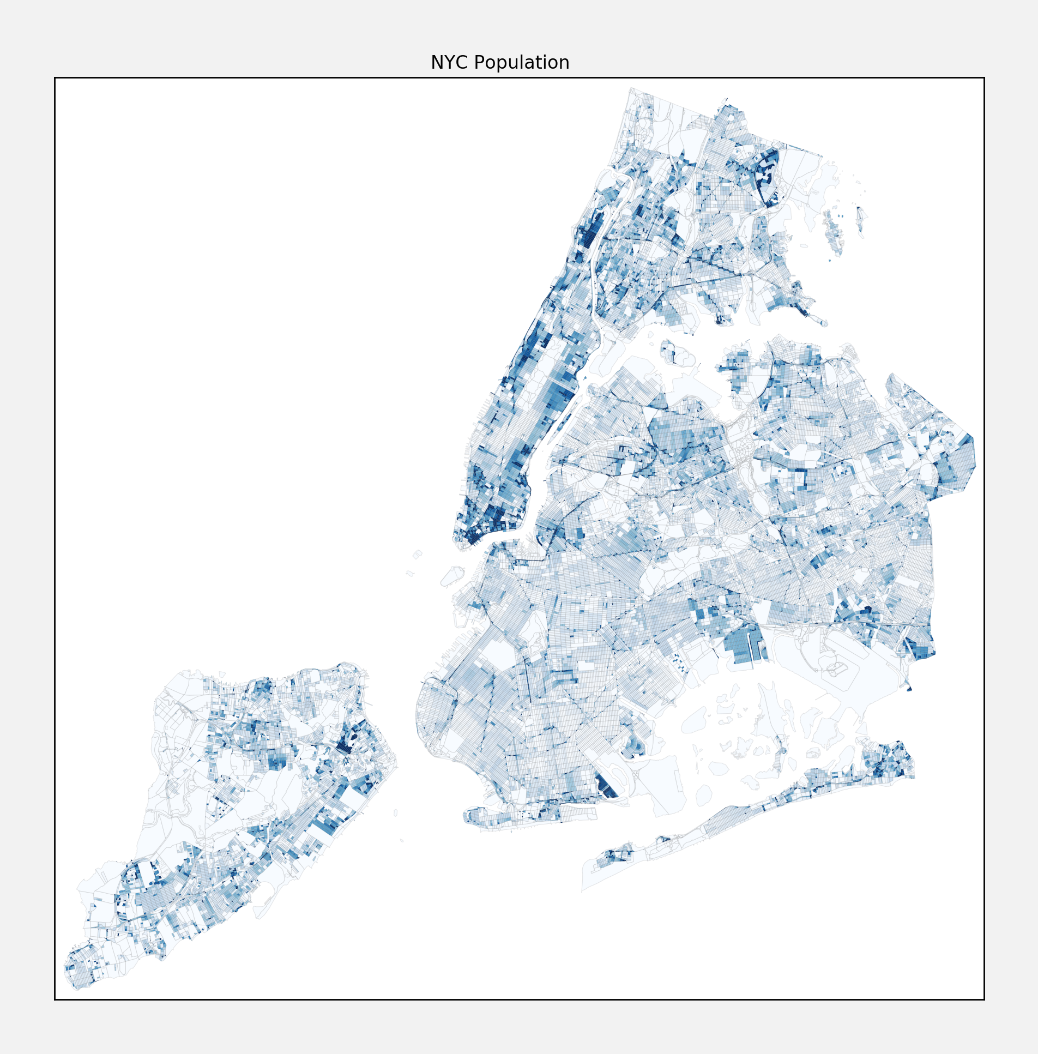

Conclusion & Future Directions
Mixture effects of O₃, NO₂, and PM₂.₅ on mortality may be weaker and especially dependent on spatial, county-level factors
NO₂ may be a more influential component compared to O₃ and PM₂.₅
Future studies could pursue:
additional pollutants and health outcomes
larger populations/wider geographical range
other environmental and meteorological covariates
Other types of adjustment for spatial and temporal confounding
Notes:
In sum, this study provides some evidence for a potential weak but positive association between pollutant mixtures and all-cause mortality, particularly when spatial factors are not controlled. Further research is needed to evaluate these relationships in broader populations and with more accurate adjustment for spatial and temporal confounding.

Slide 14
References
Turner MC, Jerrett M, Pope CA 3rd, Krewski D, Gapstur SM, Diver WR, Beckerman BS, Marshall JD, Su J, Crouse DL, Burnett RT. Long-Term Ozone Exposure and Mortality in a Large Prospective Study. Am J Respir Crit Care Med. 2016 May 15;193(10):1134-42. doi: 10.1164/rccm.201508-1633OC. PMID: 26680605; PMCID: PMC4872664.
Pablo Orellano, Julieta Reynoso, Nancy Quaranta, Ariel Bardach, Agustin Ciapponi, Short-term exposure to particulate matter (PM10 and PM2.5), nitrogen dioxide (NO2), and ozone (O3) and all-cause and cause-specific mortality: Systematic review and meta-analysis, Environment International, Volume 142, 2020, 105876, ISSN 0160-4120, https://doi.org/10.1016/j.envint.2020.105876.
Wan Hu, Junnan Yang, Effect of ambient ozone pollution on disease burden globally: A systematic analysis for the global burden of disease study 2019, Science of The Total Environment, Volume 926, 2024, 171739, ISSN 0048-9697, https://doi.org/10.1016/j.scitotenv.2024.171739.
World Health Organization. (‎2021)‎. WHO global air quality guidelines: particulate matter (‎PM2.5 and PM10)‎, ozone, nitrogen dioxide, sulfur dioxide and carbon monoxide. World Health Organization. https://iris.who.int/handle/10665/345329. License: CC BY-NC-SA 3.0 IGO
Jin, T., Amini, H., Kosheleva, A. et al. Associations between long-term exposures to airborne PM2.5 components and mortality in Massachusetts: mixture analysis exploration. Environ Health 21, 96 (2022). https://doi.org/10.1186/s12940-022-00907-2
Mahdieh Danesh Yazdi, Heresh Amini, Yaguang Wei, Edgar Castro, Liuhua Shi, Joel D. Schwartz, Long-term exposure to PM2.5 species and all-cause mortality among Medicare patients using mixtures analyses, Environmental Research,Volume 246, 2024, 118175, ISSN 0013-9351, https://doi.org/10.1016/j.envres.2024.118175.
H. Boogaard, A.P. Patton, R.W. Atkinson, J.R. Brook, H.H. Chang, D.L. Crouse, J.C. Fussell, G. Hoek, B. Hoffmann, R. Kappeler, M. Kutlar Joss, M. Ondras, S.K. Sagiv, E. Samoli, R. Shaikh, A. Smargiassi, A.A. Szpiro, E.D.S. Van Vliet, D. Vienneau, J. Weuve, F.W. Lurmann, F. Forastiere, Long-term exposure to traffic-related air pollution and selected health outcomes: A systematic review and meta-analysis, Environment International, Volume 164, 2022, 107262, ISSN 0160-4120, https://doi.org/10.1016/j.envint.2022.107262.
Alexander P. Keil, Jessie P. Buckley, Katie M. O’Brien, Kelly K. Ferguson, Shanshan Zhao, Alexandra J. White, A quantile-based g-computation approach to addressing the effects of exposure mixtures, Environmental Health Perspectives, Volume 128, Issue 4, 2020, Article 047004, https://doi.org/10.1289/EHP5838.
Hyun Woo Lee, Hyo Jin Lee, Sohee Oh, Jung-Kyu Lee, Eun Young Heo, Deog Kyeom Kim, Combined effect of changes in NO₂, O₃, PM₂.₅, SO₂ and CO concentrations on small airway dysfunction, Respirology, Volume 29, Issue 5, 2024, Pages e15025, ISSN 1323-7799, https://doi.org/10.1111/resp.14687.
X. Wu et al., Evaluating the impact of long-term exposure to fine particulate matter on mortality among the elderly.Sci. Adv.6,eaba5692(2020).DOI:10.1126/sciadv.aba5692
MODIS Land Science Team, MOD13 Vegetation Indices Product, NASA MODIS, https://modis.gsfc.nasa.gov/data/dataprod/mod13.php.
Linling Yu, Wei Liu, Xing Wang, Zi Ye, Qiyou Tan, Weihong Qiu, Xiuquan Nie, Minjing Li, Bin Wang, Weihong Chen, A review of practical statistical methods used in epidemiological studies to estimate the health effects of multi-pollutant mixture, Environmental Pollution, Volume 306, 2022, 119356, ISSN 0269-7491, https://doi.org/10.1016/j.envpol.2022.119356.
U.S. EPA. Integrated Science Assessment (ISA) for Ozone and Related Photochemical Oxidants (Final Report, Apr 2020). U.S. Environmental Protection Agency, Washington, DC, EPA/600/R-20/012, 2020.
Yi = β₀ + ψS_{i} + ɛ
weighted index S_{i} = ∑^{n}_{i=1} w_{i} * q_{i}

